Slide 1
Puzzle Test

Slide 2
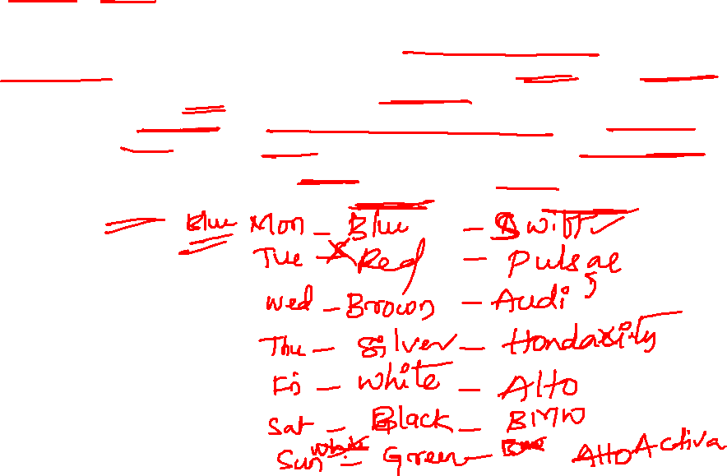
Shyam has seven vehicles namely, Alto, Swift, Honda City, Activa, Pulsar, BMW and Audi. He uses different vehicle on different days of the same week from Monday to Sunday to go to office, but not necessarily in the same order. Each vehicle has different color, that is, black, brown, white, red, silver, blue and green, but not necessarily in the same order. Audi is brown and he rides it on Wednesday. He does not ride BMW on Sunday and it is not white. He rides Swift immediately before Pulsar. The one which is green is not used on any of the days on or before Friday. Swift is not used on any day after Audi. White vehicle is used immediately after Honda City. Pulsar is not silver. He does not ride blue vehicle immediately before or after Audi. Activa is not used on any of the days before that of Alto. The one which has black color is used on Saturday.
Notes:
Monday- Swift- blue
Tuesday- pulsar- Red
Wed- AUDI- Brown
Thus- Hondacity- silver
Fri- Alto- White
Sat- BMW- Black
Sun- Activa- Green

Slide 3
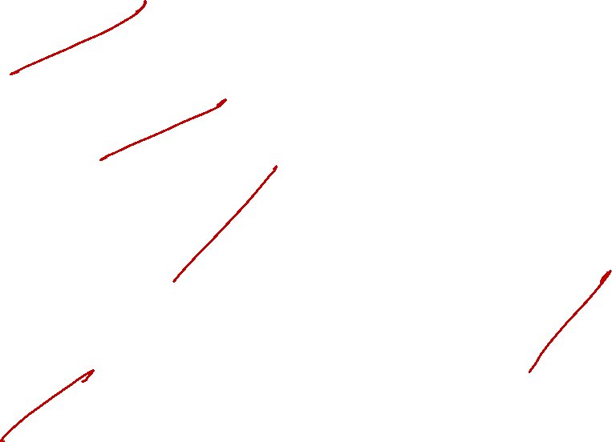
1. On which of the following day, does he ride Swift?
A) Monday B) Tuesday C) Wednesday D) Thursday
2. What is the color of Activa?
A) Blue B) Green C) Red D) Black
3. Which of the following vechile, does he ride on Saturday?
A) Audi B) Alto C) BMW D) Pulsar
4. Which of the following does not belong to the group?
A) Alto-White B) Audi-Brown C) Activa-Green D) Swift-Black
5. Which of the following vechile is of brown color?
A) Audi B) Alto C) BMW D) Pulsar
Notes:
Monday
Green
BMW
Swift- Black
Audi

Slide 4
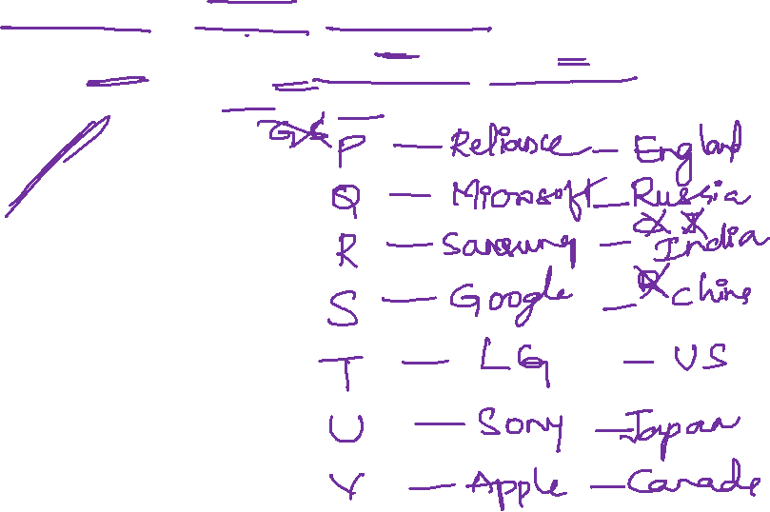
A group of seven friends, P, Q, R, S, T, U and V belongs to different countries India, Russia, US, China, Japan, England and Canada, and works for different companies viz Google, Microsoft, Samsung, Apple, Sony, LG and Reliance, but not necessarily in the same order. R works for Samsung and is neither belongs to Canada nor Japan. T belongs to US and works for LG. P belongs to England and does not work for Google or Sony. The one who belongs to Russia works for Microsoft. The one who works for Google belongs to China. U works for Sony. V works for Apple and belongs to Canada. S does not belong to Russia. Who amongst the following belongs to Russia?
A) R B) Q C) U D) S
Notes:
R- Realiance – England
Q- Microsoft- Rusiia
R- samsunng- India
S- Google- china
T- LG- US
U- Sony- Japan
V- Apple- Canada

Slide 5

2. R belongs to which of the following country?
A) China B) Russia C) India D) None
3. which of the following combination is correct
A) P-England-Microsoft
B) S-Japan-Google
C) U-Russia-Sony
D) V-Canada-Apple
4. The person belongs to which country who works for Reliance?
A) Japan B) Russia C) China D) England
5. Which company does Q work
A) Microsoft B) Reliance C) Google D) None
Notes:
2. C
3. C
4. D
5. A

Slide 6
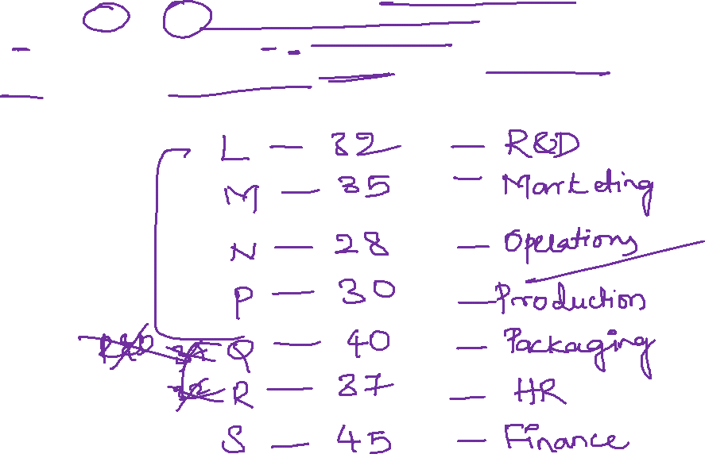
There are seven people — L, M, N, P, Q, R and S whose age are 28, 30, 32, 35, 37, 40, and 45 but not necessarily in the same order. They work in different departments, viz HR, Operations, Marketing, Finance, R&D, Production, Packaging but not necessarily in the same order. N whose age is 28 works neither in HR nor in R&D. P works in Production and he is 30. Q and R are not 32 and neither of them works in R&D. M whose age is 35 works in Marketing. The one whose age is 40 works in the Packaging Department. S whose age is 45 works in Finance. Q's age is not 37.
Notes:
L – 32- R and D
M- 35- Marketing
N- 28- operation
P- 30- production
Q- 40- packeging
R- 37- HR
S- 45- Finance

Slide 7

1. What is Q’s Age?
A) 40 B) 32 C) 45 D) None
2. N works in which of the following Department?
A) Packaging B) Operations C) Production D) Finance
3. Which of the following statement Is true?
A) L is 37 and works in HR Department
B) R is 32 and works in R&D Department
C) Q is 40 and works in Packaging Department
D) All are true

Slide 8
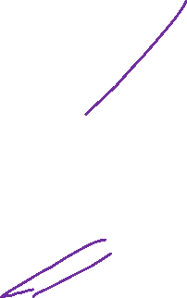
4. What is the difference between the age of Q and L?
A) 5 B) 8 C) 2 D) None
5. Which of the following statement is True
A) S-40-packaging
B) Q-40-Marketing
C) P-32-Production
D) L-32-R&D

Slide 9
Five boxes P, Q, R, S, and T contain five different sweets i.e. Ladoo, Jalebi, Barfi, Rabri, and Faluda but not necessarily in the same order, are placed one above the other in a sweet shop. S does not contain Rabri. The box which contains Rabri is not placed at the bottom. Q contains Barfi. Two boxes are placed between the box containing Jalebi and P, which does not contain Ladoo. The box containing Ladoo, is placed above S. S does not contain Jalebi and is not placed near to P. R is placed immediately above the box containing Jalebi.
Notes:
P- Rabri
Q- Barfi
R- Ladoo
T- Jilebi
S- Faluda

Slide 10
Which of the following boxes contain Faluda?
P B) S C) R D) T
2. The box at the top contains which of the following sweets?
Jalebi B) Barfi C) Faluda D) Rabri
3. Which of the following boxes is placed immediately below the box containing ladoo?
A) R B) S C) P D) T
Notes:
S
2. D
3. D

Slide 11
4. Find the correct combination?
Q-Rabri
P-Barfi
S-Jilebi
R-Ladoo
5. Find the correct statement?
One box is kept below S
S contains Jalebi
S is placed immediately below T
Three boxes are kept above S
Notes:
4. D
5. C

Slide 12
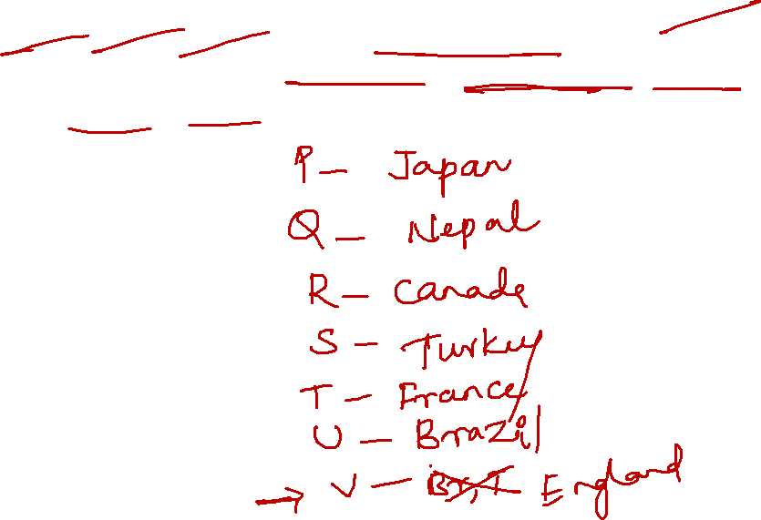
Direction: Study the following data carefully and answer the questions accordingly. Seven people P, Q, R, S, T, U, and V visit seven different counties for a health survey. These countries are Turkey, England, Japan, Nepal, Canada, France, and Brazil. Q does not visit England. Q and V do not visit Brazil and Turkey. R visits Canada. S does not visit Brazil. P and T visit Japan and France respectively.
Notes:
P- Japan
Q- Nepal
R- Canada
S- Turkey
T- France
U- Brazil
V- England

Slide 13
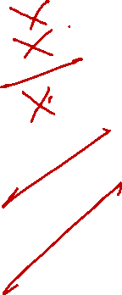
1. Who visits Turkey
A) V B) T C) U D) S
2. Who visits England?
A) Q B) U C) S D) V
3. which of the following combination is correct?
A) Q visits Brazil
B) T does not visit France
C) V does not Visit Turkey
D) U visits Canada
4. who among the following visits Japan?
A) P B) T C) V D) S
5. U visits which of the following countries
A) Brazil B) Japan C) Canada D) Turkey
Notes:
D
D
C
A
A

Slide 14
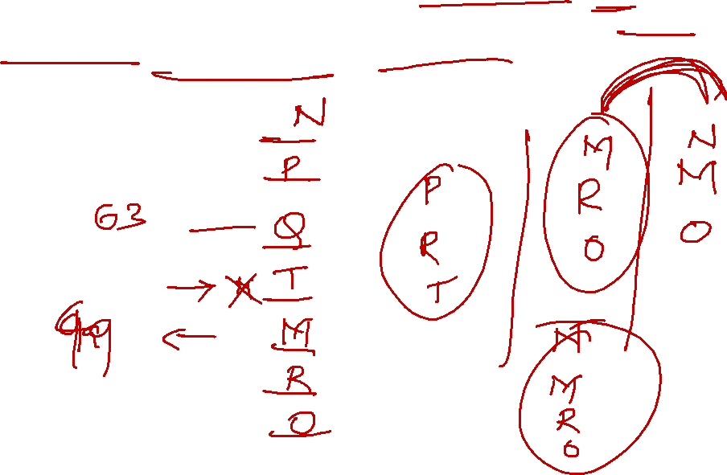
Direction: Study the following information carefully and answer the given questions. Amongst seven friends - M, N, 0, P, Q, R and T each have different weights. Only two persons are heavier than Q. P is heavier than R and T. M is not the fourth lightest person. R is heavier than 0 but lighter than M. P is just heavier than Q. M is lighter than N but heavier than 0.
Notes:
P
T
Q
N
M
R
O

Slide 15
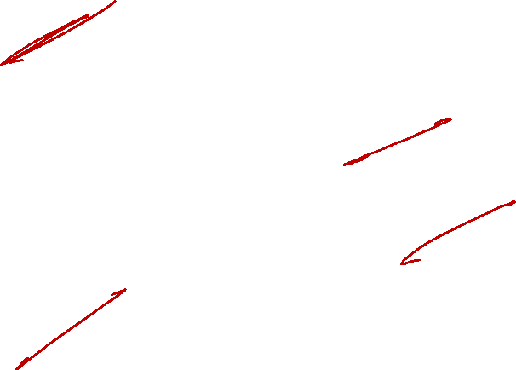
If the weight of M and Q are 49kg and 63kg respectively then what may be possible weight of T?
56 kg B) 65 kg C) 45 kg D) 28 kg
2. How many persons are heavier than R?
Three B) Two C) one D) More than four
3. Who is just lighter than Q?
P B) M C) N D) T
4. Who is heaviest?
A) N B) T C) R D) O

Slide 16
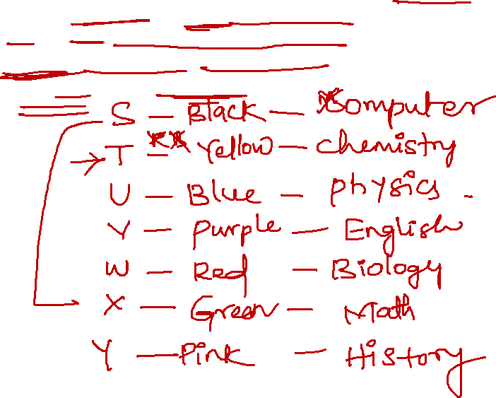
Seven friends S, T, U, V, W, X, and Y like seven different subjects, viz English, Computer, Physics, Chemistry, Biology, Math and History but not necessarily in the same order. Each of them likes different colours, viz Red, Pink, Blue, Green, Yellow, Black, and Purple but not necessarily in the same order. U likes Blue but he does not like Computer or History. T likes Chemistry but he does not like either Purple or Black. W likes Biology and Red Colour. The one who likes Green also likes Math. V likes English. Y like Pink Colour. S does not like Math. The one who likes Black also likes Computer.
Notes:
S- black computer
T- yellow- chemistry
U- Blue- Physics
V- Purple- English
W- Red- Biology
X- Green - Maths
Y- Pink- history

Slide 17

1. Which of the following combination is true?
A) X — Maths- Green B) Y — Computer — Black
C) Y — History — Green D) U — History — Pink
2. S likes which of the following colour
A) Blue B) Green C) Black D) None
3. who among the following likes green colour?
A) S B) T C) W D) X
4. who among the following likes computer?
A) T B) S C) X D) Y
5. Y likes which of the following subject
A) History B) English C) Chemistry D) Maths
Notes:
C
C
D
B
a

Slide 18
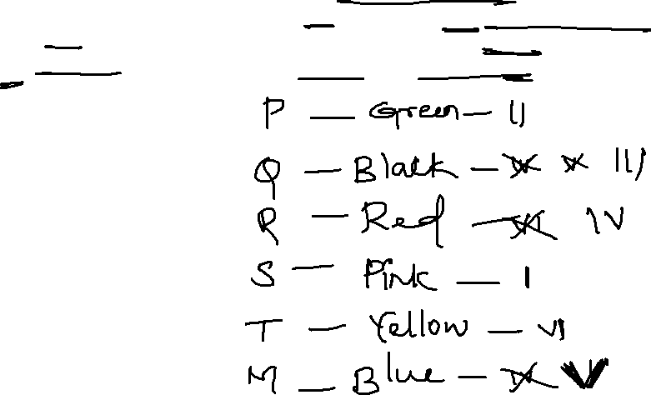
Direction: Study the following information carefully and answer the questions given below. P, Q, R, S, T and M are six students of a school, each studies in class I-VI. Each of them has a favourite colour from red, black, blue, yellow, pink and green, not necessarily in the same order. Q likes black and does not study in Class IV or V. The one who studies in Class IV does not like green. P studies in Class II. M likes blue and does not study in Class IV. The one who likes yellow studies in Class VI. S likes pink and studies in Class I. R does not study in Class VI.
Notes:
P- green – II
Q- Black- III
R Red- Iv
S- Pink- I
T- Yellow- VI
M- Blue- V

Slide 19

1. In which class does R study?
A) V B) III C) IV D) None
2. Which colour does R like?
A) Black B) Yellow C) Green D) Red
3. which colour does P like?
A) Green B) Yellow C) Red D) None
4. which of the following combination is correct?
A) P-II-Yellow B) Q-III-Green
C) T-VI-Yellow D) None
5. in which class does M study
A) IV B) III C) II D) V
Notes:
C
D
A
A
D

Slide 20
Direction: Study the following information carefully and answer the questions given below. A, B, C, D, E, F, and G are seven friends. Each of them likes a particular fruit, viz. Apple, Banana, Pear, Guava, Orange, Mango, and Watermelon, and each of them has a favourite city, viz. Mumbai, Pune, Delhi, Kolkata, Chennai, Hyderabad, and Cochin. The choices of fruit and favourite city of the seven friends are not necessarily in the same order. B likes Mango and her favourite city is Chennai. The one whose favourite city is Pune likes Watermelon. E's favourite city is Kolkata. C likes Guava and his favourite city is not Mumbai. G's favourite city is Cochin and he does not like either Banana or Pear. The favourite city of the one who likes Orange is Hyderabad. E does not like Pear. A's favourite city is neither Pune nor Hyderabad. D does not like Watermelon.
Notes:
A- Pear- Mumbai
B- Mango- Chennai
C- Guava- Delhi
D- Orange- Hyd
E- Banana- Kolkata
F- Water- Pune
G- Apple- cochin

Slide 21
1. Who likes Apple?
A) G B) E C) F D) A
2. Which fruit does A like
A) Apple B) Orange C) Pear D) Watermelon
3. which is C’s favorite City
A) Mumbai B) Pune C) Hyderabad D) Delhi
4. which of the following combination is incorrect?
A) C-Guava-Kolkata B) F-Watermelon-Hyderabad
C) D-Guava- Delhi D) All are incorrect
5. which is F’s favourite city?
A) Hyderabad B) Pune C) Mumbai D) None
Notes:
A
C
D
D
B

Slide 22


